Slide 1
Edge Detection

Slide 2
Edge Detection?
“The ability to measure gray-level transitions in a meaningful way.”
(R.C. Gonzales & R. E. Woods – Digital Image Processing, 2nd Edition, Prentice-Hall, 2001)

Slide 3
Gray-Level Transition
Ideal
Ramp

Slide 4
The First Derivative
Original
First Derivative

Slide 5


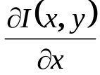

Detecting the Edge (1)
Original
First Derivative
TRSH

Slide 6

Detecting the Edge (2)
Original
First Derivative
TRSH

Slide 7
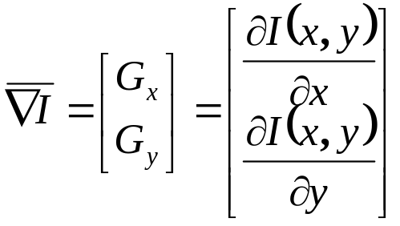
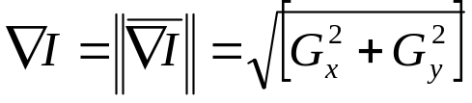
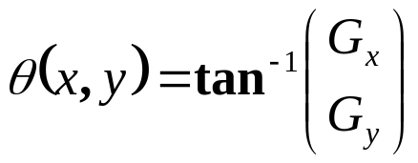
Gradient Operators
The gradient of the image I(x,y) at location (x,y), is the vector:
The magnitude of the gradient:
The direction of the gradient vector:

Slide 8
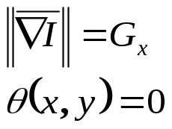
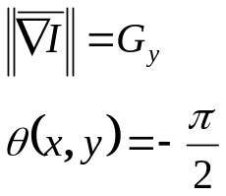
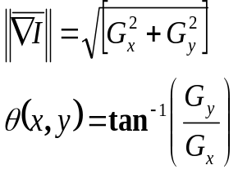
The Meaning of the Gradient
It represents the direction of the strongest variation in intensity
Vertical
Horizontal
Generic
Edge Strength:
Edge Direction:
The direction of the edge at location (x,y) is perpendicular to the gradient vector at that point

Slide 9
Calculating the Gradient
For each pixel the gradient is calculated, based on a 3x3 neighborhood around this pixel.
z₁ | z₂ | z₃
z₄ | z₅ | z₆
z₇ | z₈ | z₉

Slide 10
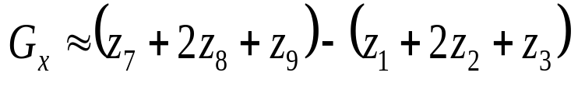
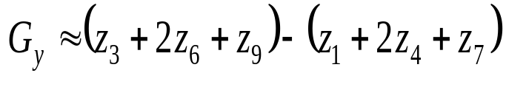
The Sobel Edge Detector
-1 | -2 | -1
0 | 0 | 0
1 | 2 | 1
-1 | 0 | 1
-2 | 0 | 2
-1 | 0 | 1

Slide 11
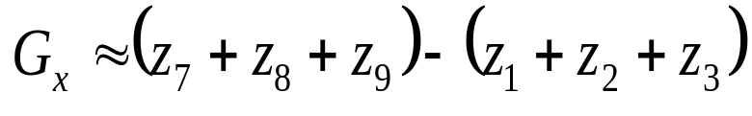
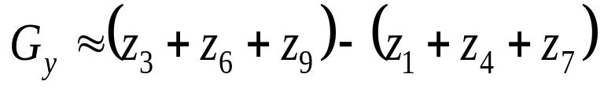
The Prewitt Edge Detector
-1 | -1 | -1
0 | 0 | 0
1 | 1 | 1
-1 | 0 | 1
-1 | 0 | 1
-1 | 0 | 1

Slide 12
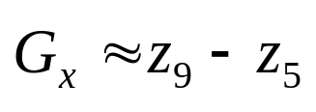
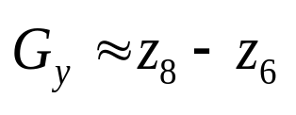
The Roberts Edge Detector
0 | 0 | 0
0 | -1 | 0
0 | 0 | 1
0 | 0 | 0
0 | 0 | -1
0 | 1 | 0
The Roberts Edge Detector is in fact a 2x2 operator

Slide 13
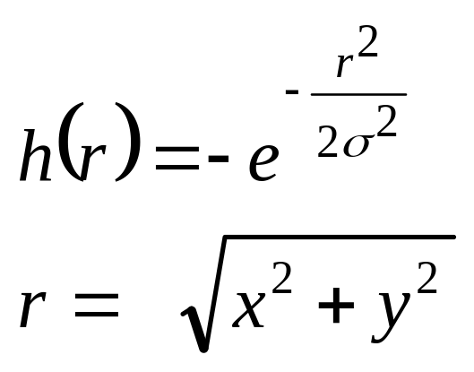
The Canny Method
Two Possible Implementations:
The image is convolved with a Gaussian filter before gradient evaluation
The image is convolved with the gradient of the Gaussian Filter.

Slide 14
The Edge Detection Algorithm
The gradient is calculated (using any of the four methods described in the previous slides), for each pixel in the picture.
If the absolute value exceeds a threshold, the pixel belongs to an edge.
The Canny method uses two thresholds, and enables the detection of two edge types: strong and weak edge. If a pixel's magnitude in the gradient image, exceeds the high threshold, then the pixel corresponds to a strong edge. Any pixel connected to a strong edge and having a magnitude greater than the low threshold corresponds to a weak edge.

Slide 15
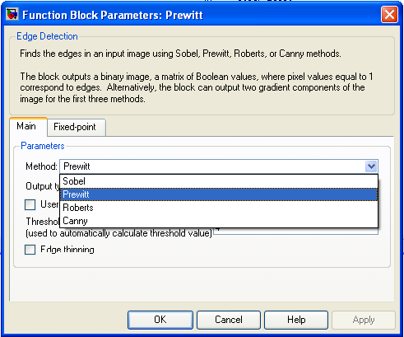
The Edge Detection Block
The Edge Detection Block supports the four methods described in the pervious slides

Slide 16
Hands-On
Simulation
Implementation using the DSK6416

Slide 17

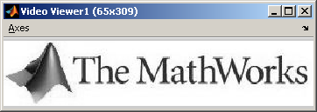
Simulation
MATLAB®
Display
Image File
Edge
Detection

Slide 18
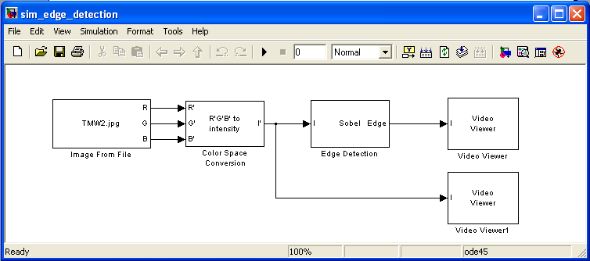
Edge Detection Simulation

Slide 19
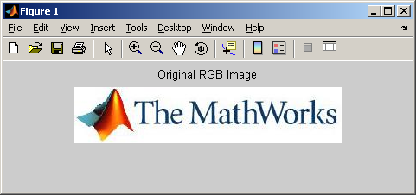
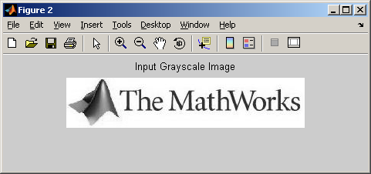
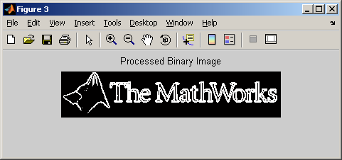
Edge Detection on Stills Images
MATLAB
Display
Image
File
Script
RGB
to Grayscale
RTDX
RTDX
DSK6416
Edge
Detection

Slide 20
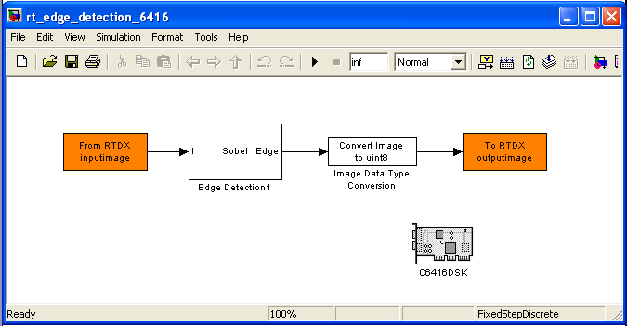
Edge Detection Using the DSK6416

Slide 21
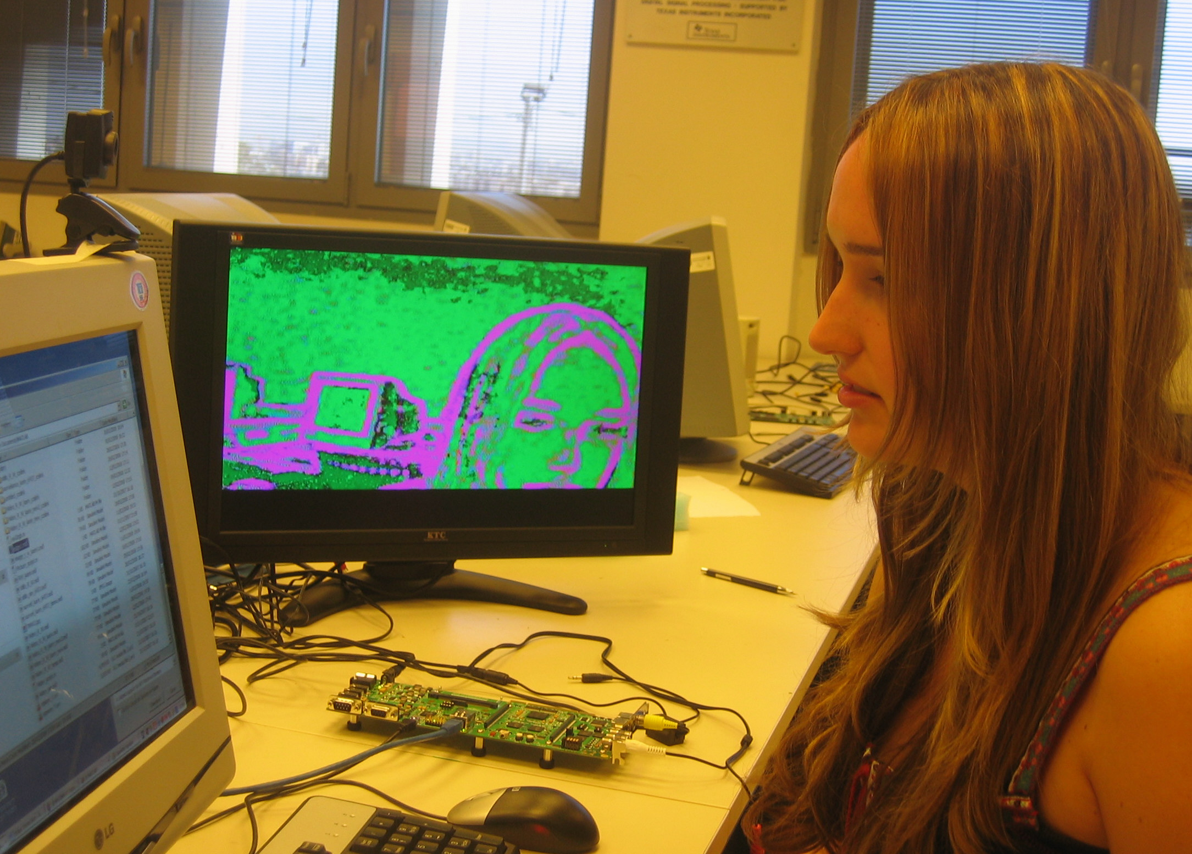
Edge Detection on Video
DM6437 DVDP
Camera
Video in
Edge
Detection
Video out
Video Screen

Slide 22
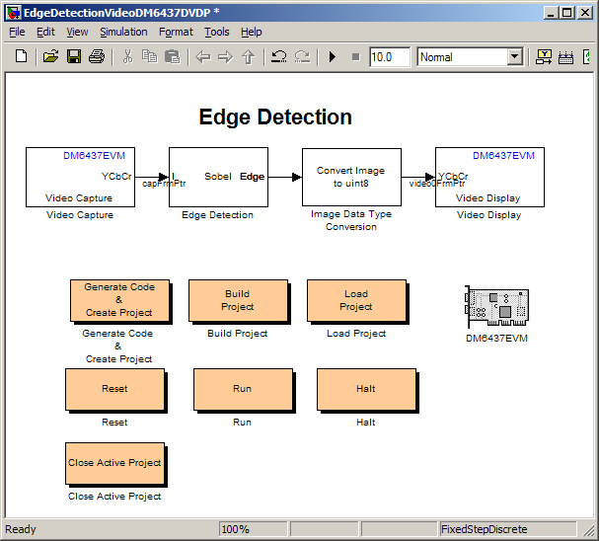
Edge Detection Real Time Model for the DM6437 DVDP

